Slide 1
MSDM 5003 Lecture 9 2 November 2023 Correlations and Power Laws
Outline:
1. Do markets follow random walks?
2. Stylized facts of markets
3. Long-time correlations
Detrended fluctuation analysis (DFA)
Power spectral density (PSD)
4. Power laws and exponential laws
5. Stock price return distribution
6. Market index return distribution
Differentiating power laws and exponential laws

Slide 2
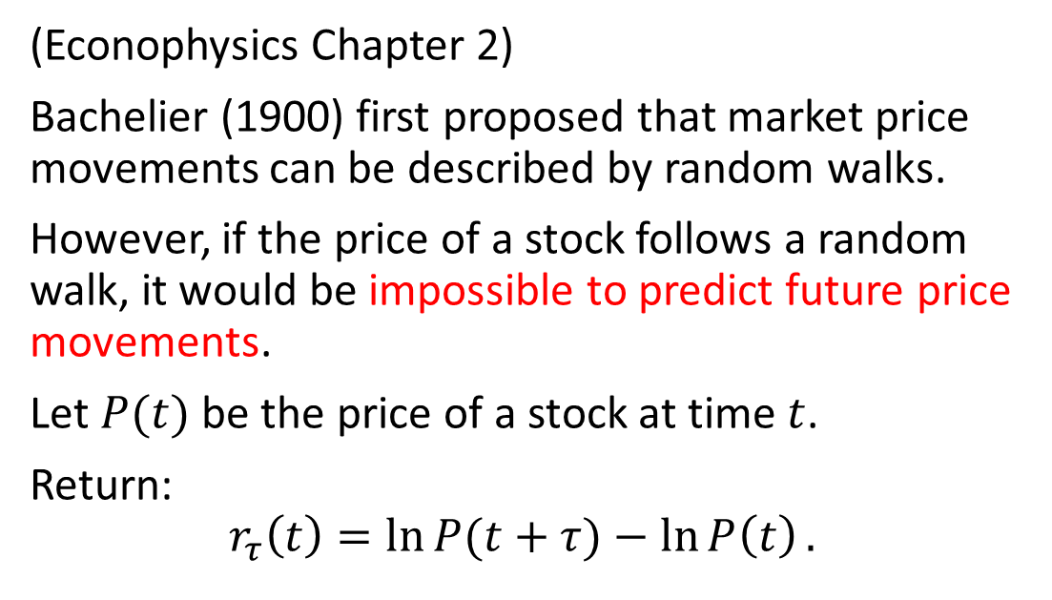
1. Do Markets Follow Random Walks?
(Econophysics Chapter 2)
Bachelier (1900) first proposed that market price movements can be described by random walks.
However, if the price of a stock follows a random walk, it would be impossible to predict future price movements.
Let $P(t)$ be the price of a stock at time $t$.
Return:
$$r_{τ}\left(t\right)=\ln{P(t+τ)}−\ln{P\left(t\right)}.$$

Slide 3
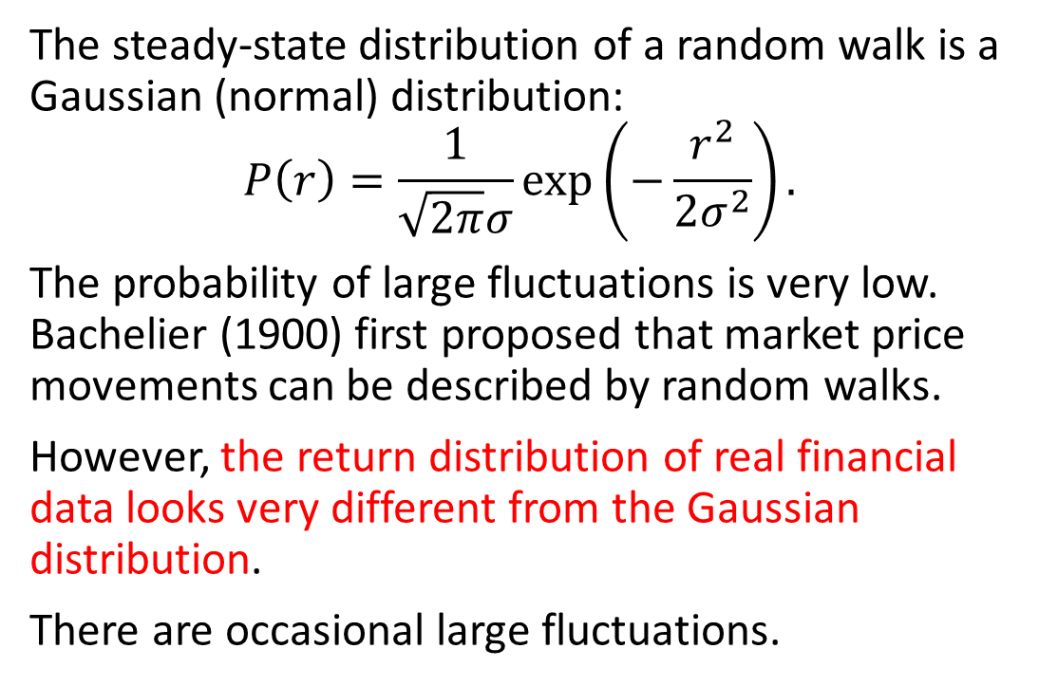
Comparison with Gaussian Distribution
The steady-state distribution of a random walk is a Gaussian (normal) distribution:
$$P\left(r\right)=\frac{1}{\sqrt{2π}σ}\exp\left(−\frac{r^{2}}{2σ^{2}}\right).$$
The probability of large fluctuations is very low. Bachelier (1900) first proposed that market price movements can be described by random walks.
However, the return distribution of real financial data looks very different from the Gaussian distribution.
There are occasional large fluctuations.

Slide 4
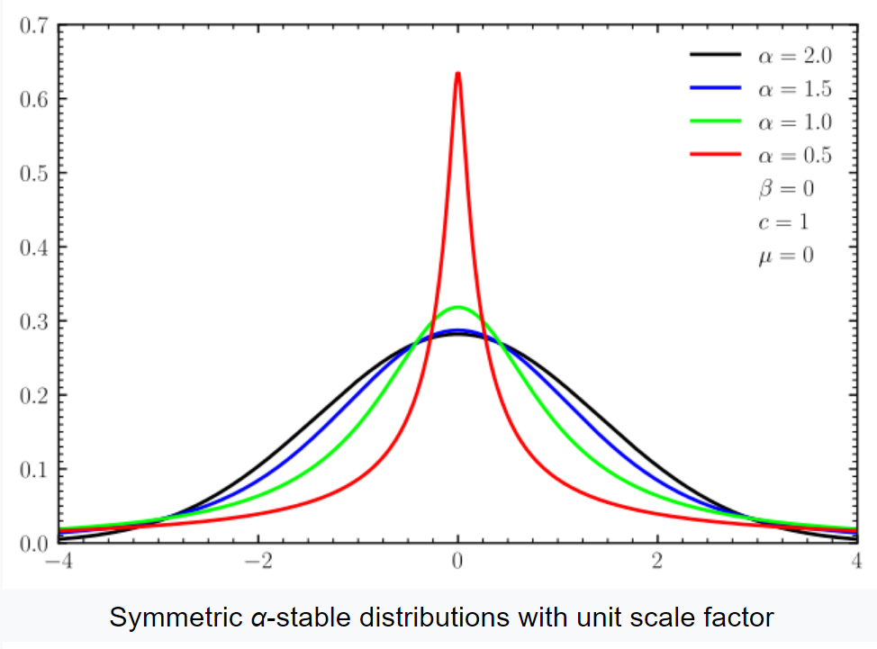
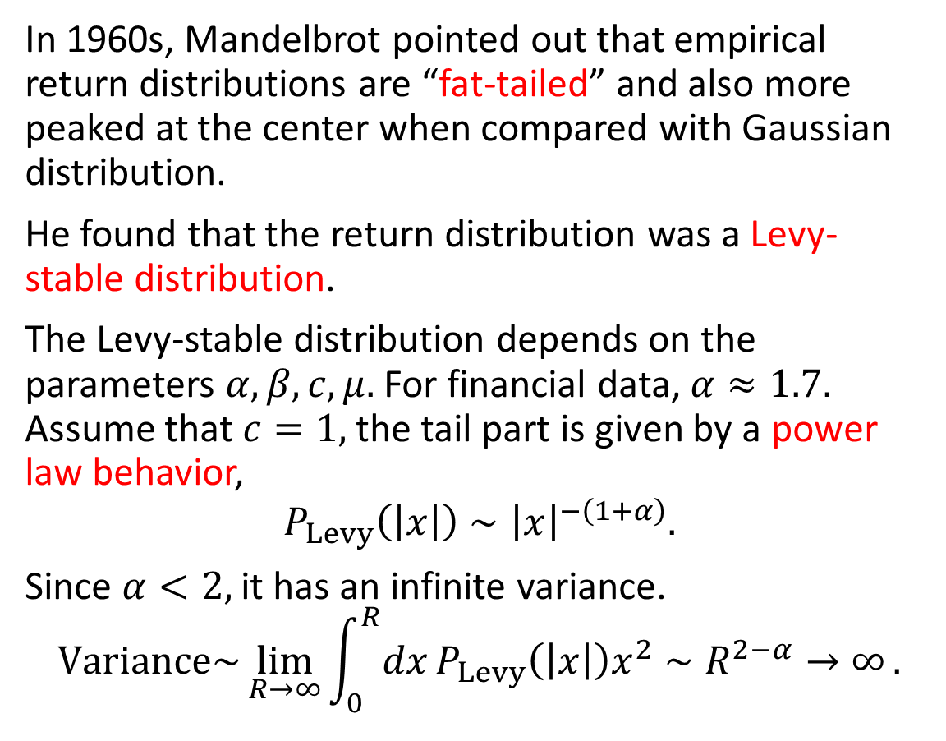
Financial Data Distributions are Fat-Tailed
In 1960s, Mandelbrot pointed out that empirical return distributions are “fat-tailed” and also more peaked at the center when compared with Gaussian distribution.
He found that the return distribution was a Levy-stable distribution.
The Levy-stable distribution depends on the parameters $α, β, c, μ.$ For financial data, $α≈1.7.$ Assume that $c=1,$ the tail part is given by a power law behavior,
$$P_{Levy}\left(\left|x\right|\right)∼{\left|x\right|}^{−\left(1+α\right)}.$$
Since $α<2,$ it has an infinite variance.
$$Variance\sim \lim_{R→∞}{\int_{0}^{R}{dx}P_{Levy}\left(\left|x\right|\right)x^{2}∼R^{2−α}→∞}.$$

Slide 5
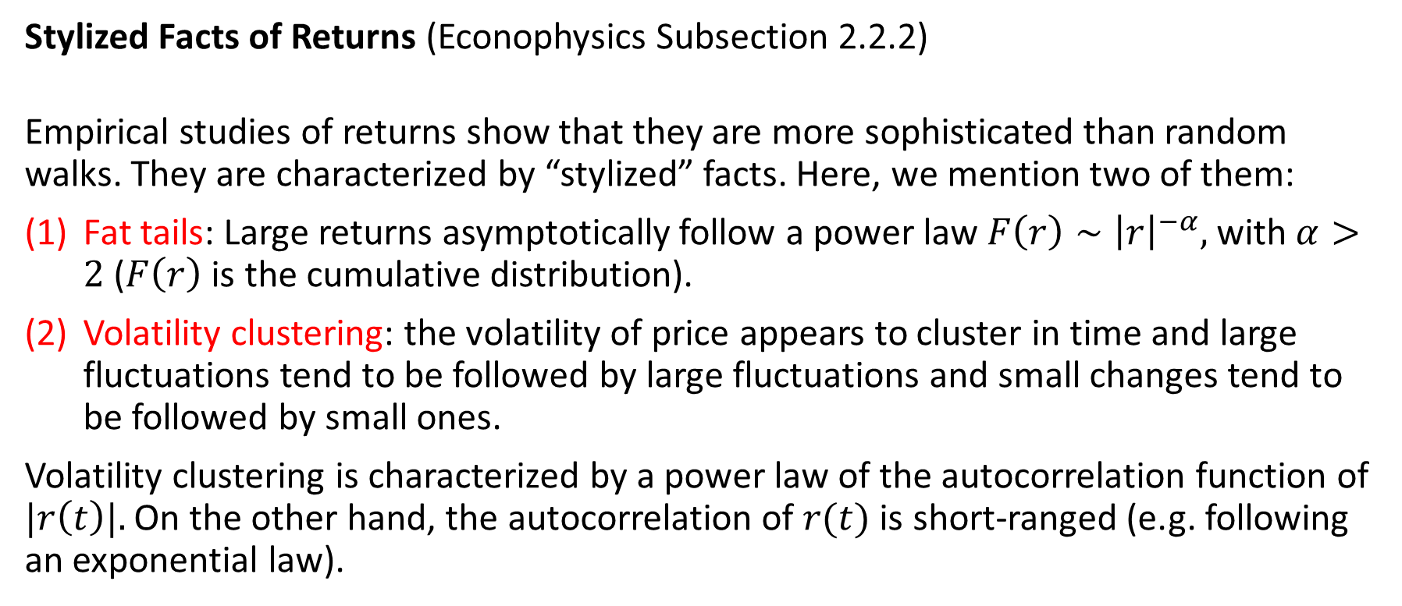
2. Stylized facts of Financial Data
Stylized Facts of Returns (Econophysics Subsection 2.2.2)
Empirical studies of returns show that they are more sophisticated than random walks. They are characterized by “stylized” facts. Here, we mention two of them:
Fat tails: Large returns asymptotically follow a power law $F\left(r\right)∼{\left|r\right|}^{−α},$ with $α>2$ ($F\left(r\right)$ is the cumulative distribution).
Volatility clustering: the volatility of price appears to cluster in time and large fluctuations tend to be followed by large fluctuations and small changes tend to be followed by small ones.
Volatility clustering is characterized by a power law of the autocorrelation function of $|r\left(t\right)|.$ On the other hand, the autocorrelation of $r(t)$ is short-ranged (e.g. following an exponential law).

Slide 6
Fat Tails
Compared with the Gaussian distribution (orange), the tail of the return distribution decays much slower, and the peak at the center is much sharper.

Slide 7
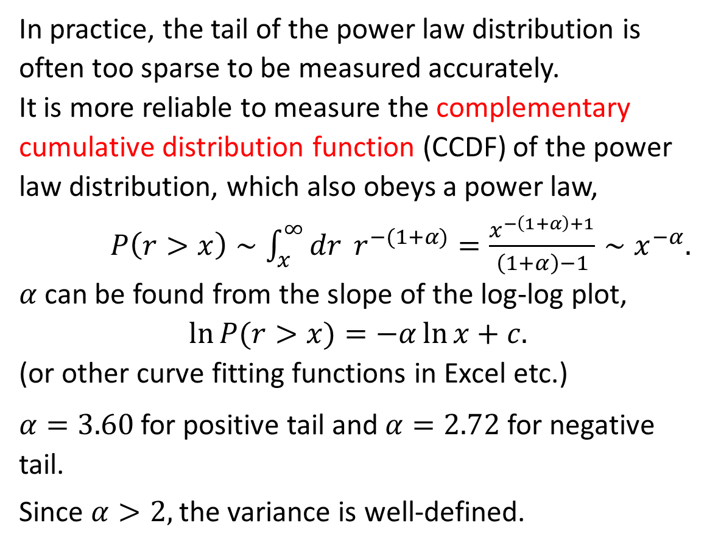
Power Laws
In practice, the tail of the power law distribution is often too sparse to be measured accurately.
It is more reliable to measure the complementary cumulative distribution function (CCDF) of the power law distribution, which also obeys a power law,
$P\left(r>x\right)∼\int_{x}^{∞}{dr} r^{−(1+α)}=\frac{x^{−\left(1+α\right)+1}}{\left(1+α\right)−1}∼x^{−α}.$
$α$ can be found from the slope of the log-log plot,
$$\ln{P(r>x)}=−α\ln{x}+c.$$
(or other curve fitting functions in Excel etc.)
$α=3.60$ for positive tail and $α=2.72$ for negative tail.
Since $α>2,$the variance is well-defined.

Slide 8
Volatility Clustering
Volatility is measured by the absolute value of the return.
Return and volatility look very different.

Slide 9
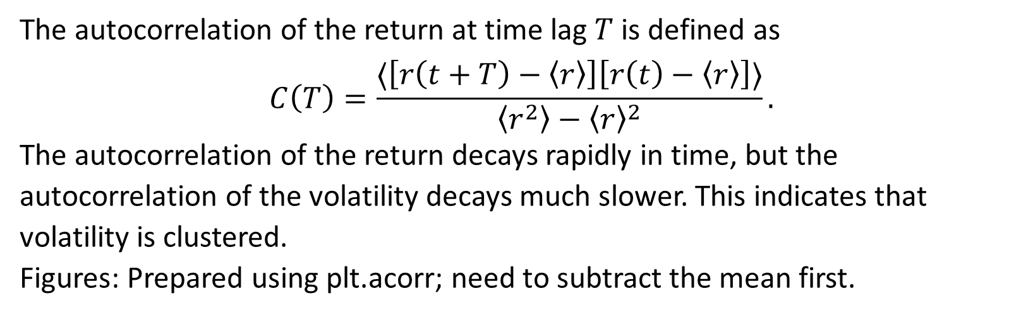
Autocorrelation
The autocorrelation of the return at time lag $T$ is defined as
$$C\left(T\right)=\frac{⟨\left[r\left(t+T\right)−\left\langle r\right\rangle \right]\left[r\left(t\right)−\left\langle r\right\rangle \right]⟩}{\left\langle r^{2}\right\rangle −{\left\langle r\right\rangle }^{2}}.$$
The autocorrelation of the return decays rapidly in time, but the autocorrelation of the volatility decays much slower. This indicates that volatility is clustered.
Figures: Prepared using plt.acorr; need to subtract the mean first.

Slide 10
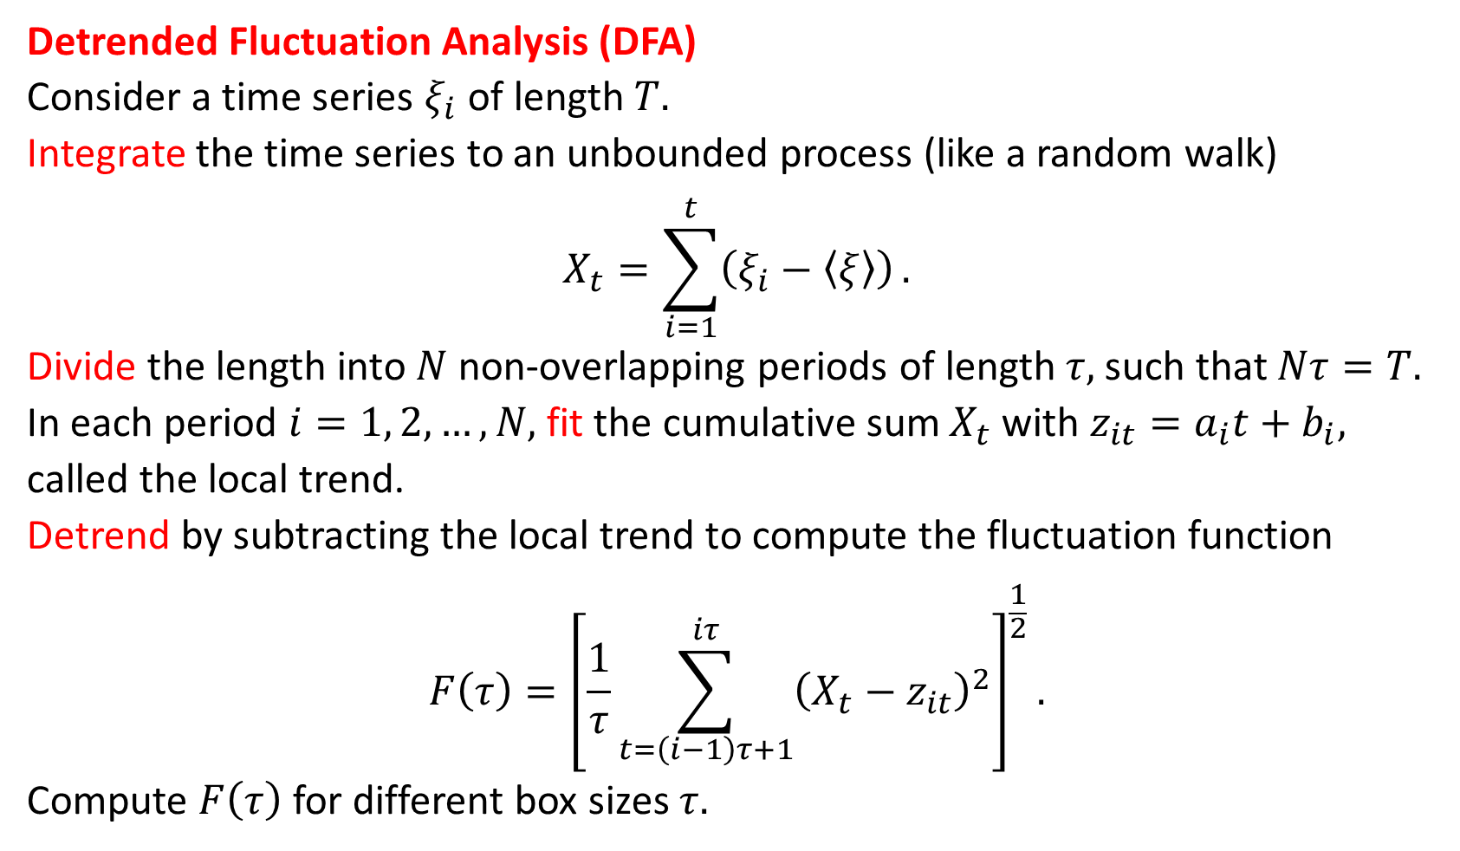
3. Long-time Correlations
Detrended Fluctuation Analysis (DFA)
Consider a time series $ξ_{i}$ of length $T.$
Integrate the time series to an unbounded process (like a random walk)
$$X_{t}=\sum_{i=1}^{t}{\left(ξ_{i}−\left\langle ξ\right\rangle \right)}.$$
Divide the length into $N$ non-overlapping periods of length $τ,$ such that $Nτ=T.$
In each period $i=1, 2, …, N,$ fit the cumulative sum $X_{t}$with $z_{it}=a_{i}t+b_{i},$ called the local trend.
Detrend by subtracting the local trend to compute the fluctuation function
$$F\left(τ\right)={\left[\frac{1}{τ}\sum_{t=\left(i−1\right)τ+1}^{iτ}{{\left(X_{t}−z_{it}\right)}^{2}}\right]}^{\frac{1}{2}}.$$
Compute $F\left(τ\right)$ for different box sizes $τ.$

Slide 11
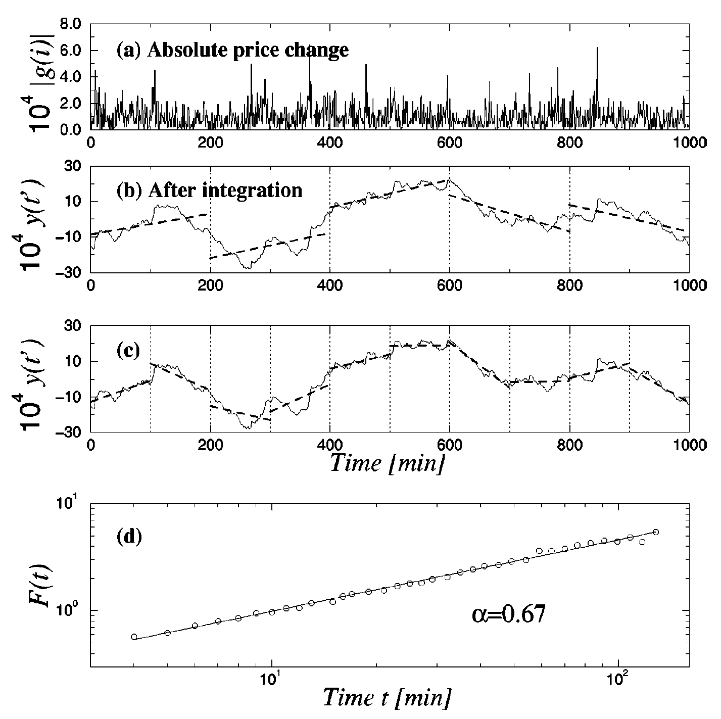
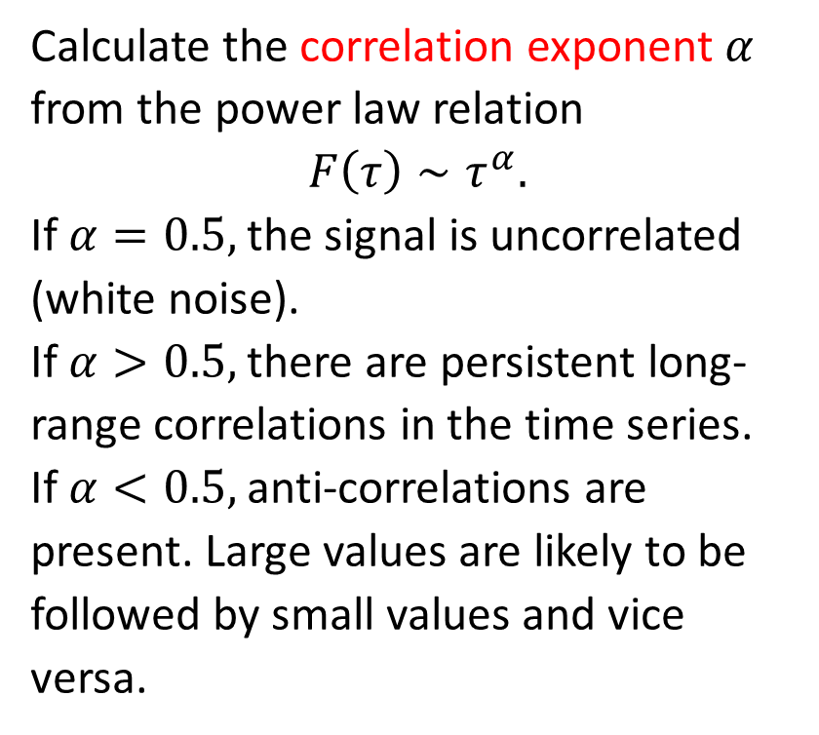
DFA¹
Calculate the correlation exponent $α$ from the power law relation
$$F\left(τ\right)∼τ^{α}.$$
If $α=0.5,$ the signal is uncorrelated (white noise).
If $α>0.5,$ there are persistent long-range correlations in the time series.
If $α<0.5,$ anti-correlations are present. Large values are likely to be followed by small values and vice versa.
¹Y. Liu, P. Gopikrishnan, P. Cizeau, M. Meyer, C.-K. Peng, and H. E. Stanley, Statistical properties of the volatility of price fluctuations, Phys. Rev. E 60, 1390-1400 (1999).

Slide 12
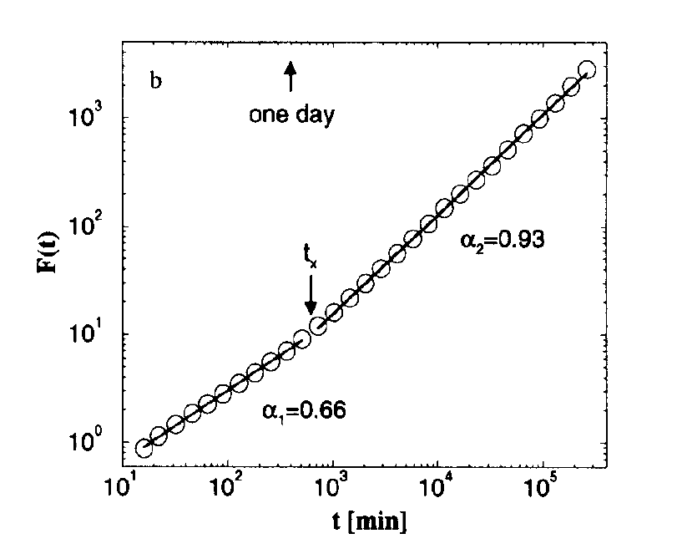
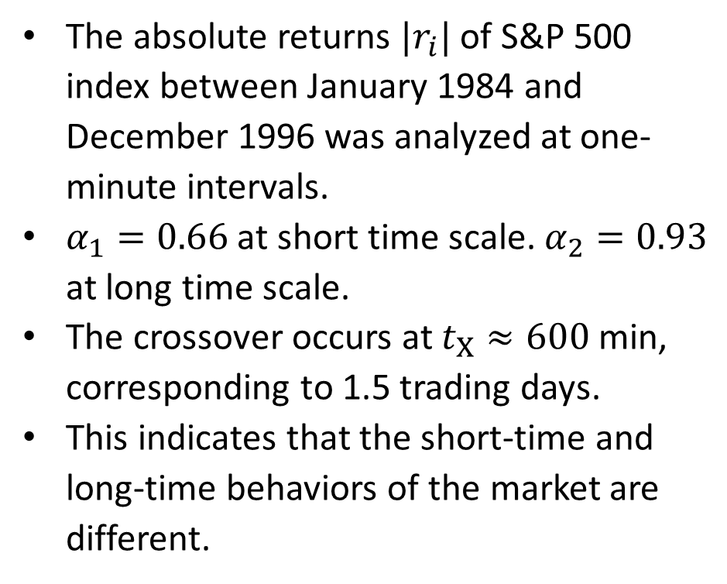
DFA of Absolute Returns²
The absolute returns $|r_{i}|$ of S&P 500 index between January 1984 and December 1996 was analyzed at one-minute intervals.
$α_{1}=0.66$ at short time scale. $α_{2}=0.93$ at long time scale.
The crossover occurs at $t_{X}≈600$min, corresponding to 1.5 trading days.
This indicates that the short-time and long-time behaviors of the market are different.
²Y. Liu, P. Cizeau, M. Meyer, C.-K. Peng, and H. E. Stanley, Correlations in Economic Time Series, Physica A 245, 437-440 (1997).

Slide 13
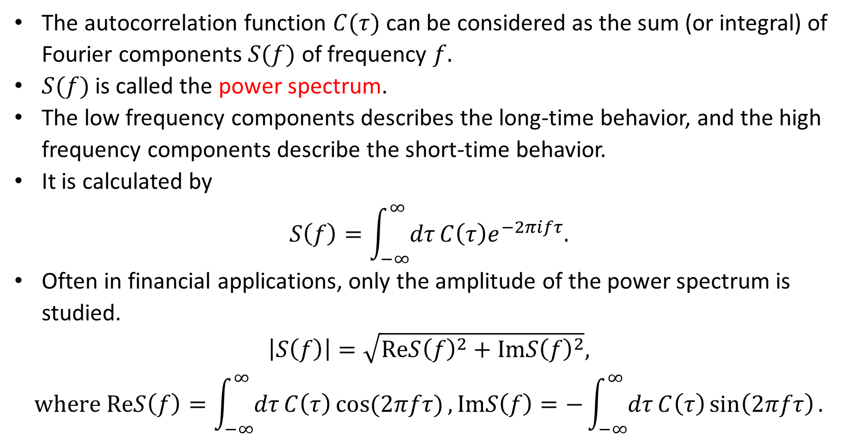
Power Spectral Density Analysis²
The autocorrelation function $C(τ)$ can be considered as the sum (or integral) of Fourier components $S(f)$ of frequency $f.$
$S(f)$ is called the power spectrum.
The low frequency components describes the long-time behavior, and the high frequency components describe the short-time behavior.
It is calculated by
$$S\left(f\right)=\int_{−∞}^{∞}{dτ}C\left(τ\right)e^{−2πifτ}.$$
Often in financial applications, only the amplitude of the power spectrum is studied.
$$\left|S\left(f\right)\right|=\sqrt{ReS{\left(f\right)}^{2}+ImS{\left(f\right)}^{2}},$$
$$where ReS\left(f\right)=\int_{−∞}^{∞}{dτ}C\left(τ\right)\cos{(2πfτ)},ImS\left(f\right)=−\int_{−∞}^{∞}{dτ}C\left(τ\right)\sin\left(2πfτ\right).$$

Slide 14
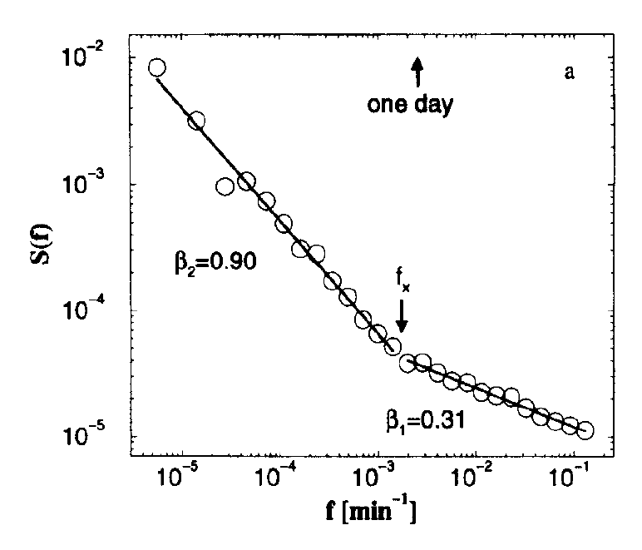
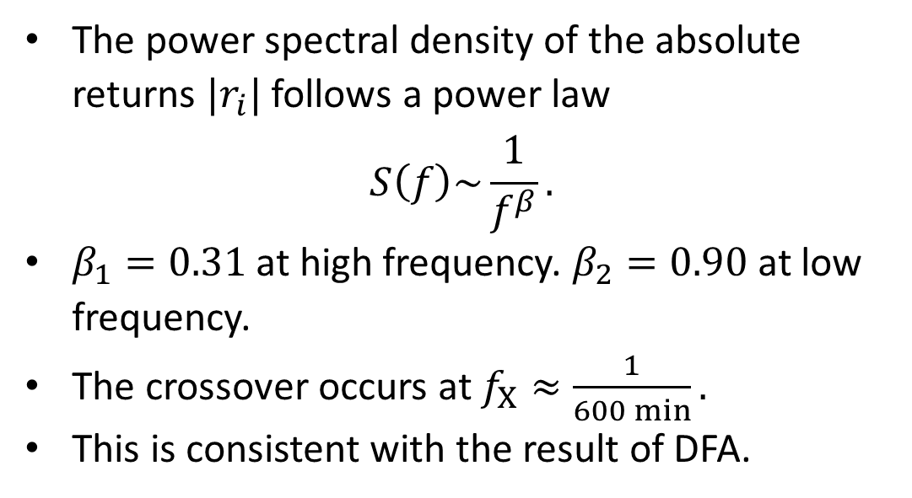
PSD of Absolute Returns
The power spectral density of the absolute returns $|r_{i}|$ follows a power law
$$S\left(f\right)\sim \frac{1}{f^{β}}.$$
$β_{1}=0.31$ at high frequency. $β_{2}=0.90$ at low frequency.
The crossover occurs at $f_{X}≈\frac{1}{600 min}.$
This is consistent with the result of DFA.

Slide 15
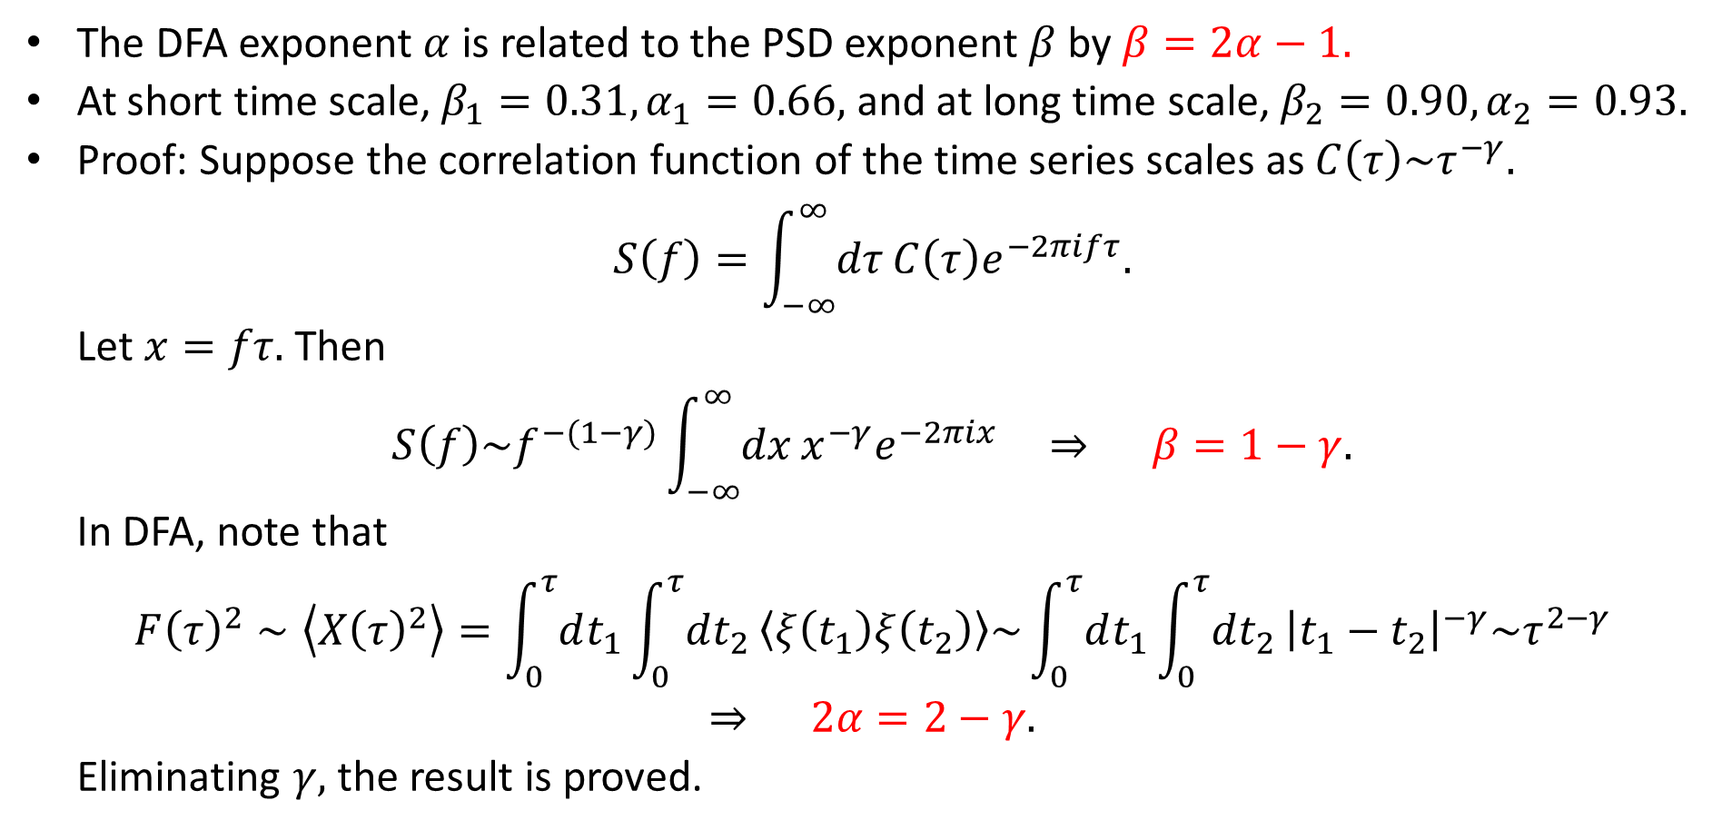
Relation of DFA and PSD Exponents
The DFA exponent $α$ is related to the PSD exponent $β$ by $β=2α−1.$
At short time scale, $β_{1}=0.31, α_{1}=0.66,$ and at long time scale, $β_{2}=0.90, α_{2}=0.93.$
Proof: Suppose the correlation function of the time series scales as $C\left(τ\right)\sim τ^{−γ}.$
$$S\left(f\right)=\int_{−∞}^{∞}{dτ}C\left(τ\right)e^{−2πifτ}.$$
Let $x=fτ.$ Then
$$S\left(f\right)\sim f^{−(1−γ)}\int_{−∞}^{∞}{dx}x^{−γ}e^{−2πix} ⇒ β=1−γ.$$
In DFA, note that
$$F{\left(τ\right)}^{2}∼\left\langle X{\left(τ\right)}^{2}\right\rangle =\int_{0}^{τ}{dt_{1}}\int_{0}^{τ}{dt_{2}}\left\langle ξ\left(t_{1}\right)ξ\left(t_{2}\right)\right\rangle \sim \int_{0}^{τ}{dt_{1}}\int_{0}^{τ}{dt_{2}}{\left|t_{1}−t_{2}\right|}^{−γ}\sim τ^{2−γ}$$
$$⇒ 2α=2−γ.$$
Eliminating $γ,$ the result is proved.

Slide 16
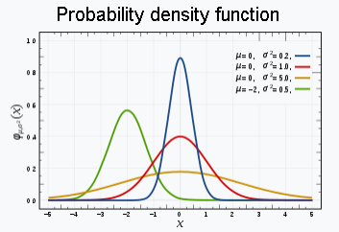
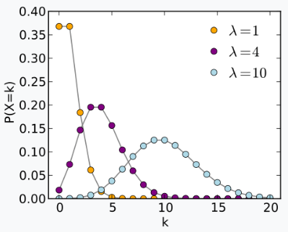
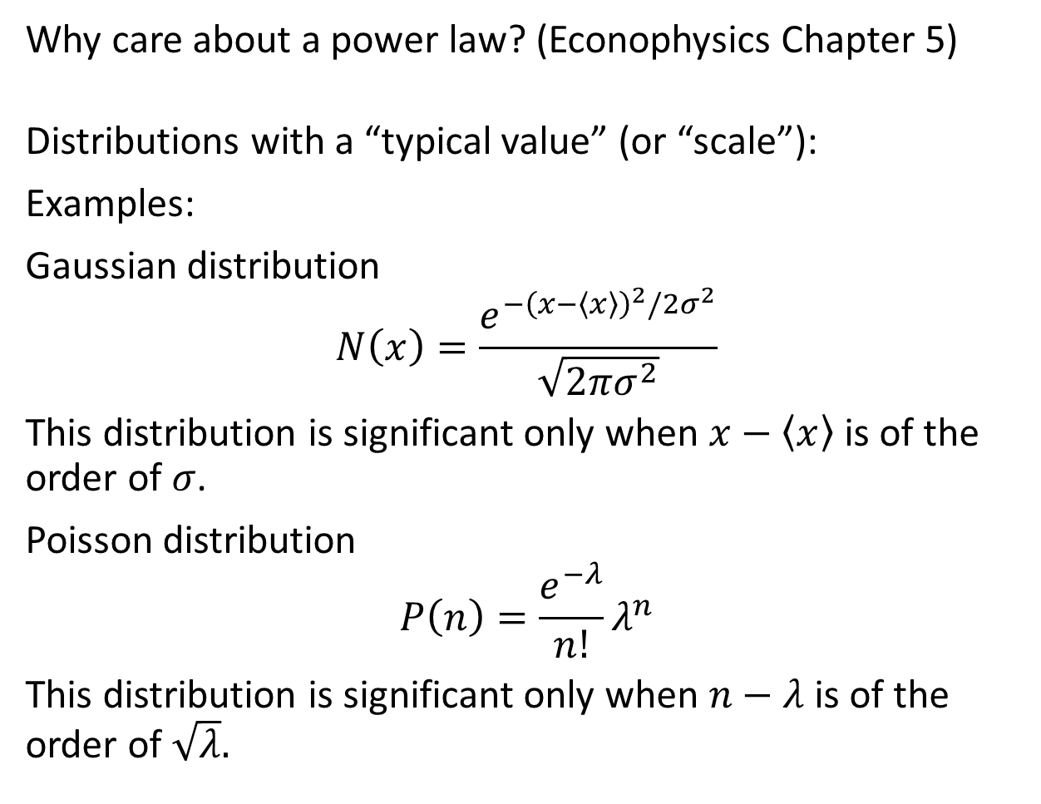
4. Power Laws and Exponential Laws
Why care about a power law? (Econophysics Chapter 5)
Distributions with a “typical value” (or “scale”):
Examples:
Gaussian distribution
$$N\left(x\right)=\frac{e^{−{\left(x−〈x〉\right)}^{2}/2σ^{2}}}{\sqrt{2πσ^{2}}}$$
This distribution is significant only when $x−〈x〉$ is of the order of $σ$.
Poisson distribution
$$P\left(n\right)=\frac{e^{−λ}}{n!}λ^{n}$$
This distribution is significant only when $n−λ$ is of the order of $\sqrt{λ}.$

Slide 17
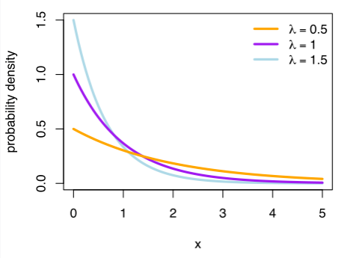
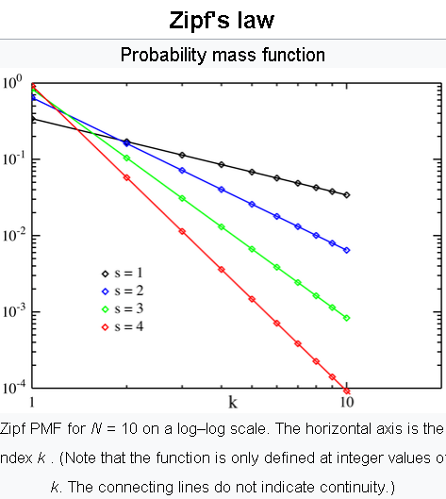
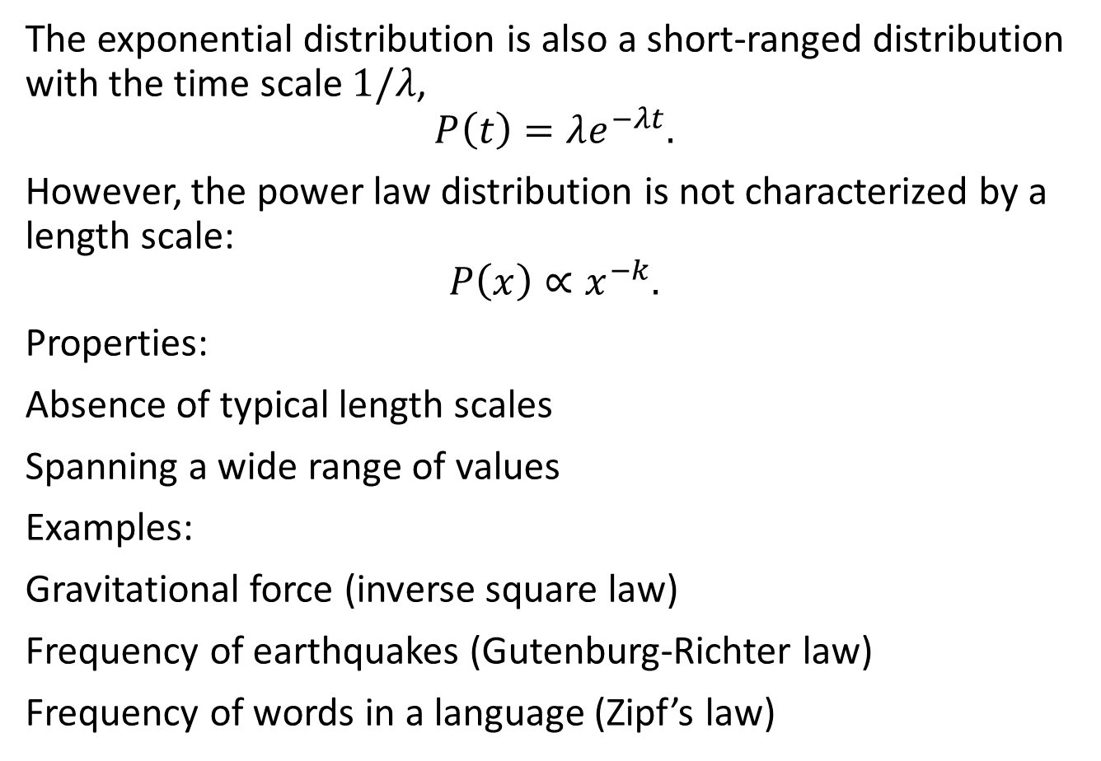
Power Laws
The exponential distribution is also a short-ranged distribution with the time scale $1/λ$,
$$P\left(t\right)=λe^{−λt}.$$
However, the power law distribution is not characterized by a length scale:
$$P\left(x\right)∝x^{−k}.$$
Properties:
Absence of typical length scales
Spanning a wide range of values
Examples:
Gravitational force (inverse square law)
Frequency of earthquakes (Gutenburg-Richter law)
Frequency of words in a language (Zipf’s law)

Slide 18
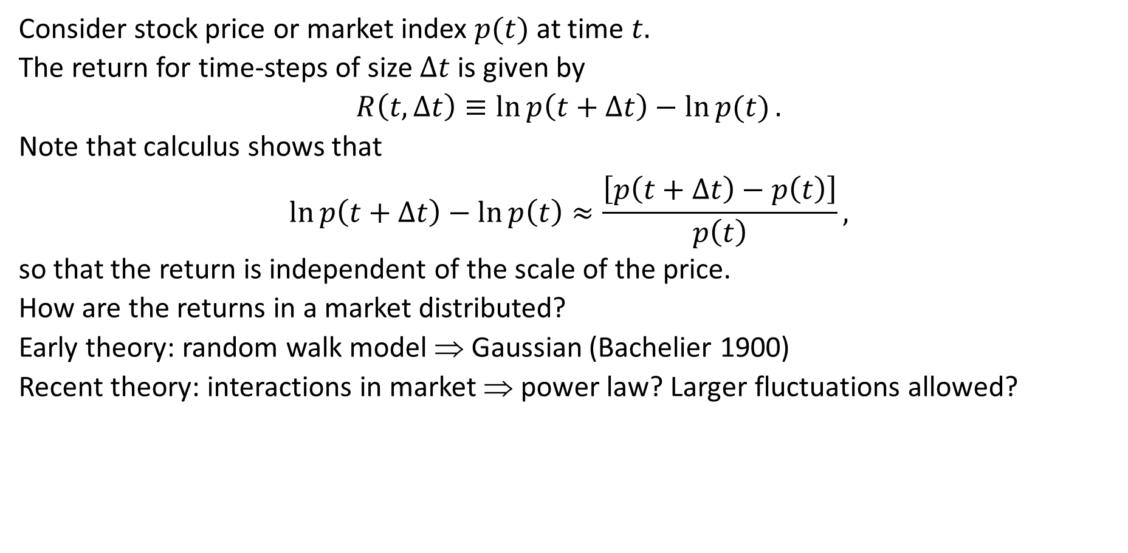
Power Laws in Finance
Consider stock price or market index $p(t)$ at time $t.$
The return for time-steps of size $Δt$ is given by
$$R\left(t,Δt\right)≡\ln{p\left(t+Δt\right)}−\ln{p(t)}.$$
Note that calculus shows that
$$\ln{p\left(t+Δt\right)}−\ln{p\left(t\right)}≈\frac{\left[p\left(t+Δt\right)−p\left(t\right)\right]}{p\left(t\right)},$$
so that the return is independent of the scale of the price.
How are the returns in a market distributed?
Early theory: random walk model ⇒ Gaussian (Bachelier 1900)
Recent theory: interactions in market ⇒ power law? Larger fluctuations allowed?

Slide 19
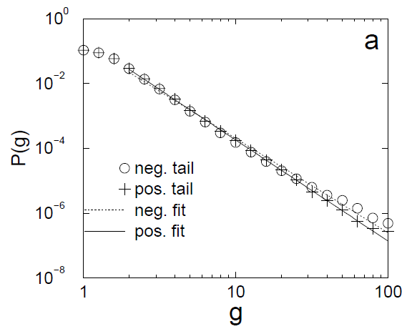
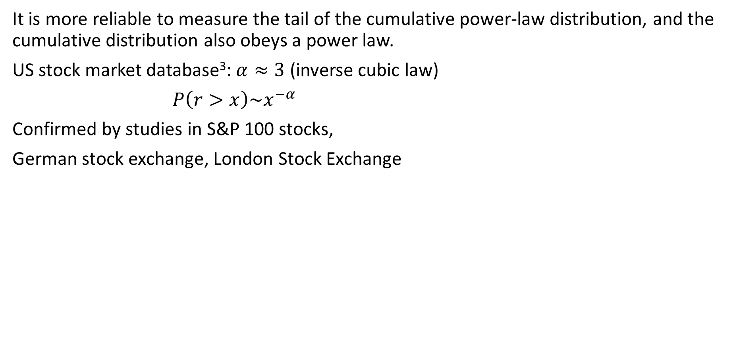
Cumulative Return Distribution
It is more reliable to measure the tail of the cumulative power-law distribution, and the cumulative distribution also obeys a power law.
US stock market database³: $α≈3$ (inverse cubic law)
$P\left(r>x\right)\sim x^{−α}$
Confirmed by studies in S&P 100 stocks,
German stock exchange, London Stock Exchange
³ Gopikrishnan P, Meyer M, Amaral LAN, and Stanley HE (1998) Inverse cubic law for the distribution of stock price variations, Eur Phys J B 3, 139-140.

Slide 20
Controversy
Developed markets: Not all power-laws
Australian stock market: positive tail closer to Gaussian
Hang Seng index: exponential
Nikkei index: exponential
Developing markets: Not all exponentials
Korean stock market: power-law changed to exponential
Some other emerging markets: inverse-cubic law
Criticism: Conclusions from graphical fitting may not be accurate, more reliable techniques required.

Slide 21
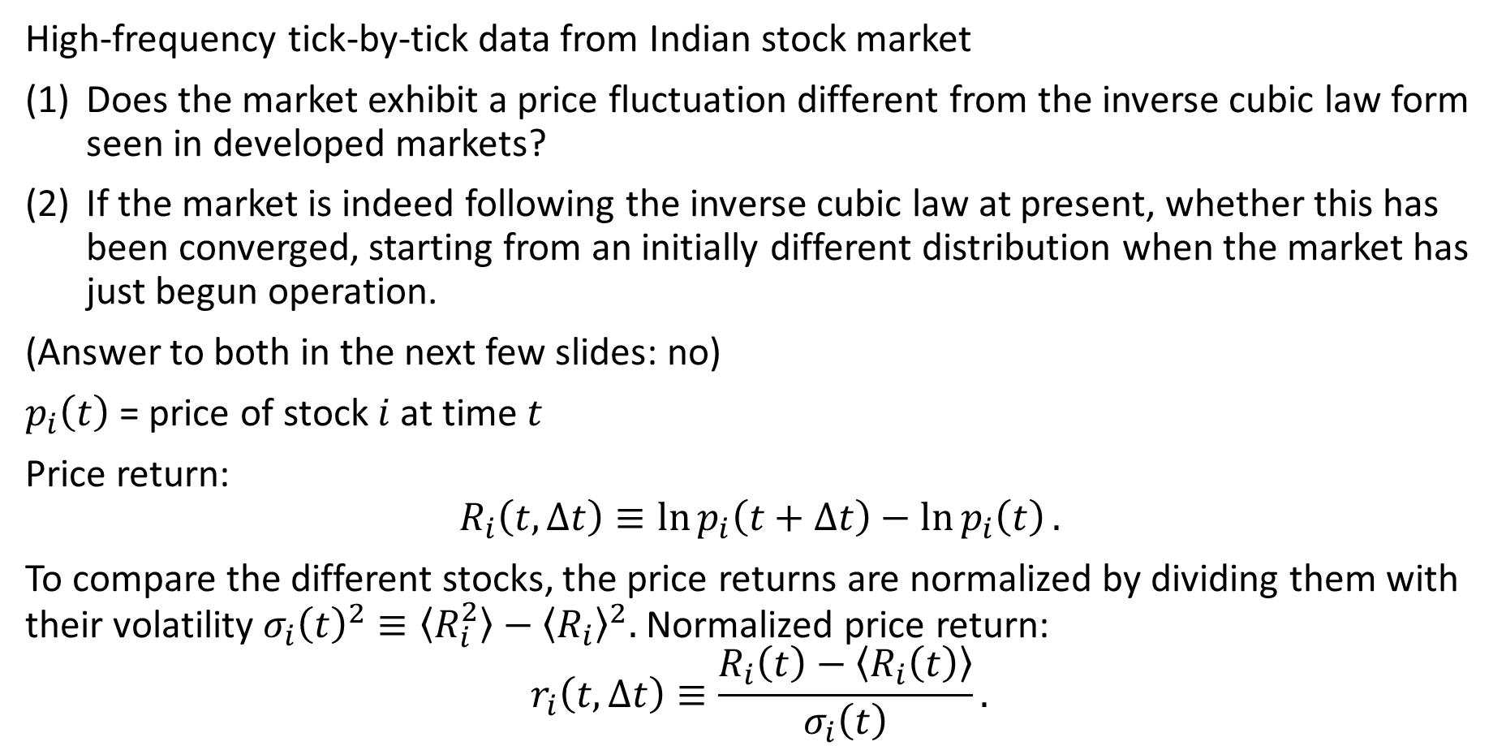
5. Stock Price Return Distribution
High-frequency tick-by-tick data from Indian stock market
Does the market exhibit a price fluctuation different from the inverse cubic law form seen in developed markets?
If the market is indeed following the inverse cubic law at present, whether this has been converged, starting from an initially different distribution when the market has just begun operation.
(Answer to both in the next few slides: no)
$p_{i}\left(t\right)$ = price of stock $i$ at time $t$
Price return:
$$R_{i}\left(t, Δt\right)≡\ln{p_{i}\left(t+Δt\right)−\ln{p_{i}\left(t\right)}}.$$
To compare the different stocks, the price returns are normalized by dividing them with their volatility $σ_{i}{\left(t\right)}^{2}≡〈R_{i}^{2}〉−{〈R_{i}〉}^{2}.$ Normalized price return:
$$r_{i}\left(t,Δt\right)≡\frac{R_{i}\left(t\right)−〈R_{i}\left(t\right)〉}{σ_{i}\left(t\right)}.$$

Slide 22
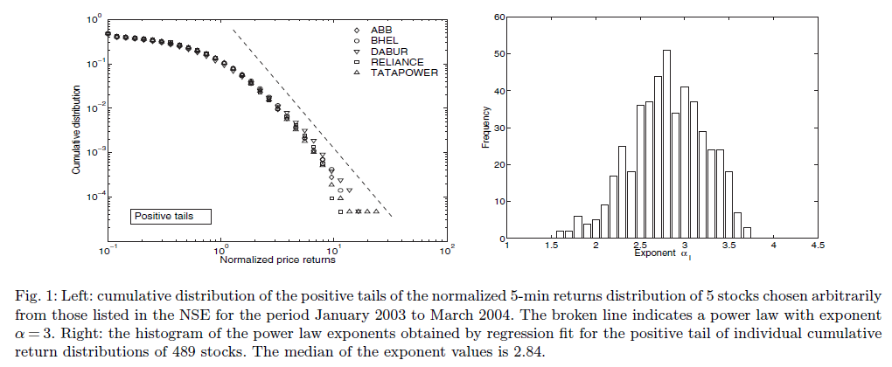
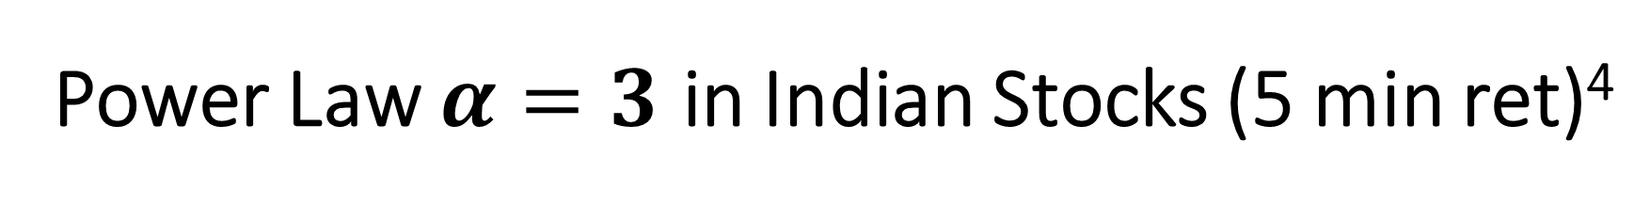
Power Law $α=3$ in Indian Stocks (5 min ret)⁴
⁴ Pan RK and Sinha S (2007) Self-organization of price fluctuation distribution in evolving markets, Europhys Lett 77, 58004.

Slide 23
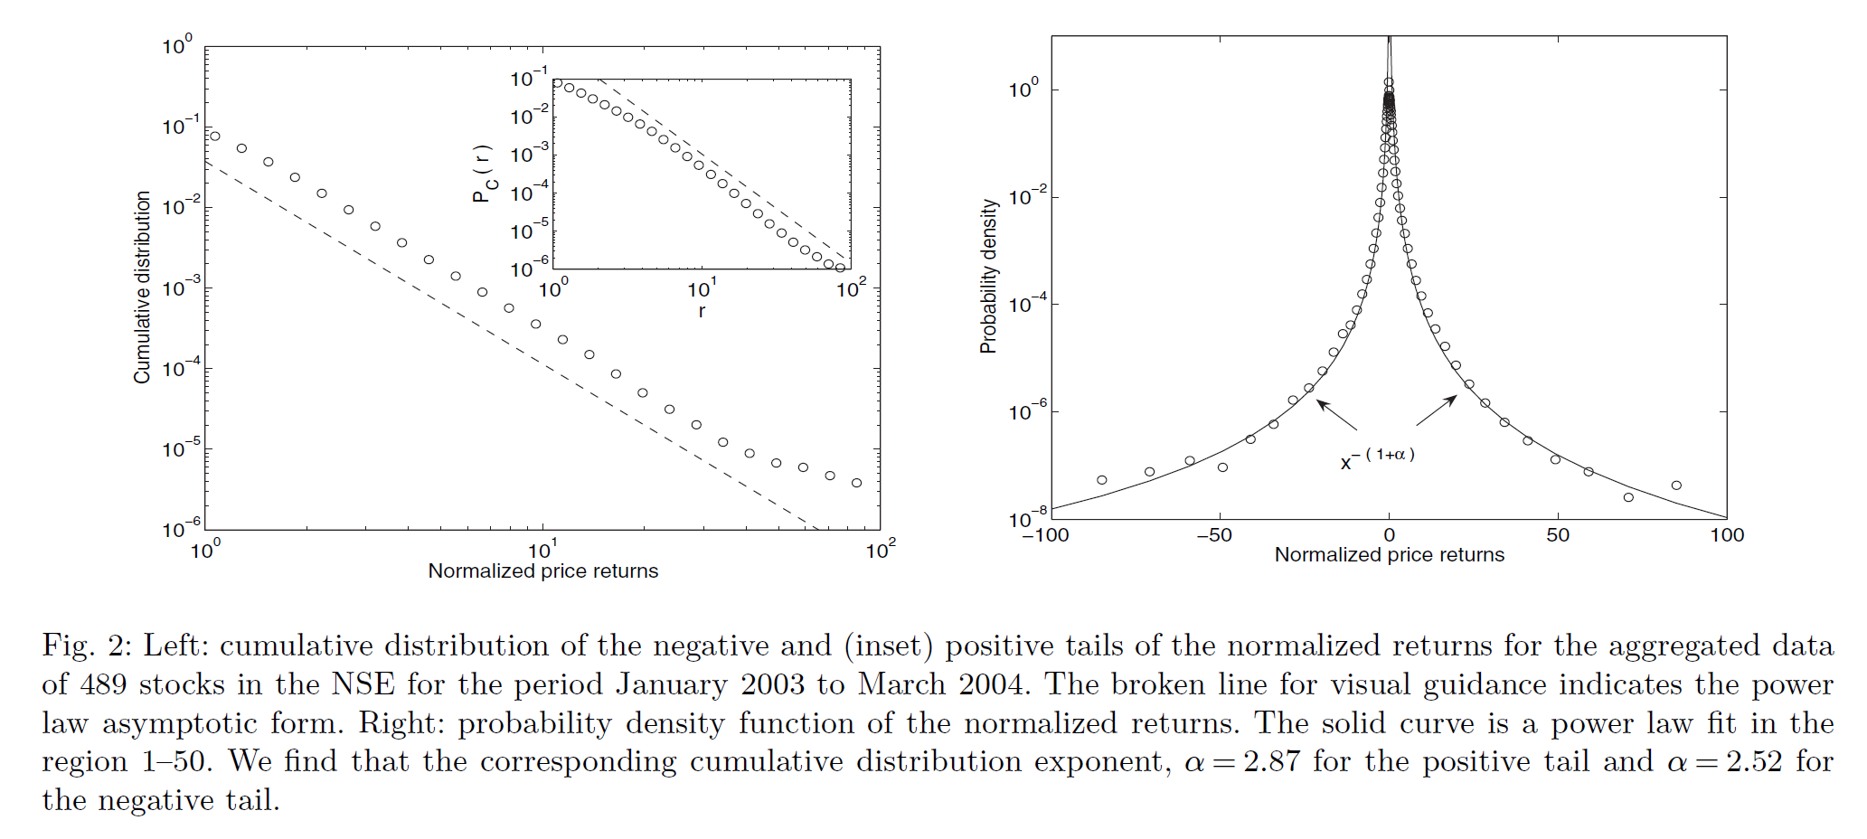
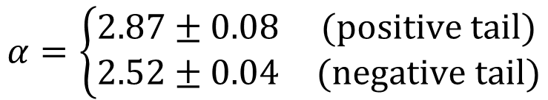
Aggregate Data (5 min, 489 stocks)
$$α=\left\{\begin{matrix}2.87±0.08 & (positive tail) \\ 2.52±0.04 & (negative tail)\end{matrix}\right.$$

Slide 24
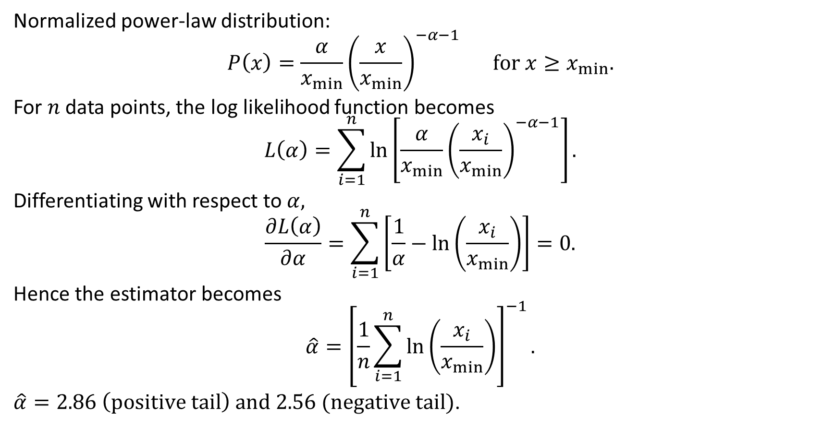
Hill Estimator of the Exponent
Normalized power-law distribution:
$$P\left(x\right)=\frac{α}{x_{min}}{\left(\frac{x}{x_{min}}\right)}^{−α−1} for x≥x_{min}.$$
For $n$ data points, the log likelihood function becomes
$$L\left(α\right)=\sum_{i=1}^{n}{\ln\left[\frac{α}{x_{min}}{\left(\frac{x_{i}}{x_{min}}\right)}^{−α−1}\right]}.$$
Differentiating with respect to $α,$
$$\frac{∂L\left(α\right)}{∂α}=\sum_{i=1}^{n}{\left[\frac{1}{α}−\ln\left(\frac{x_{i}}{x_{min}}\right)\right]}=0.$$
Hence the estimator becomes
$$\hat{α}={\left[\frac{1}{n}\sum_{i=1}^{n}{\ln\left(\frac{x_{i}}{x_{min}}\right)}\right]}^{−1}.$$
$\hat{α}=2.86 \left(positive tail\right) and 2.56 (negative tail)$.

Slide 25
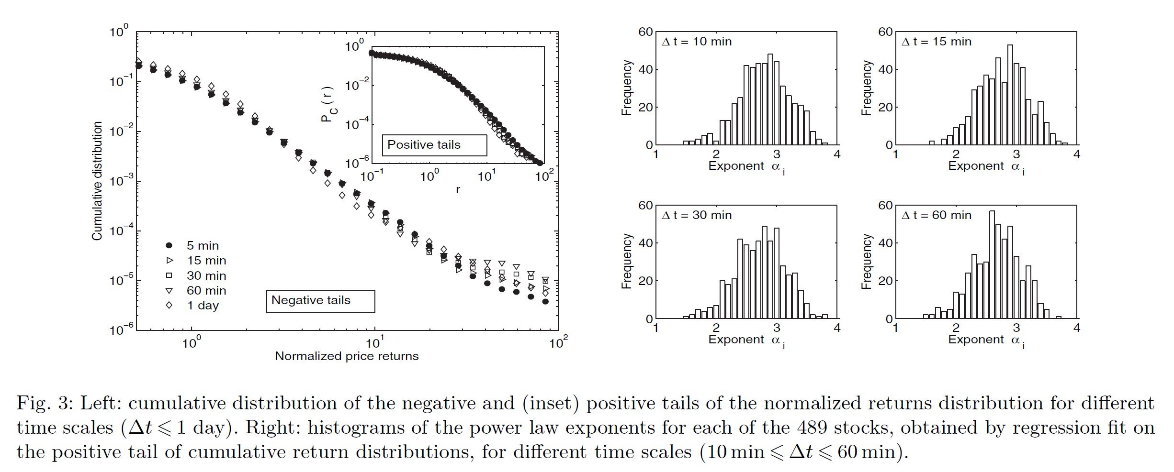

Dependence on $Δt$?
Power-law distribution for $Δt$ up to 1 day. Left: all stocks, right: individual stocks.

Slide 26
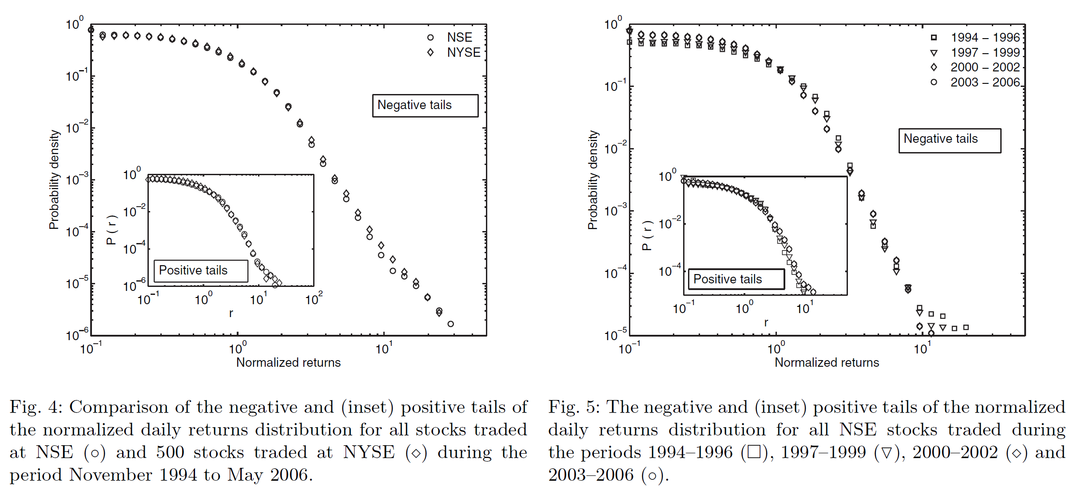
Comparison with a Mature Market
Left: Similar power laws for NYSE (mature market) and NSE (emerging market).
Right: Similar power laws for different development periods of NSE.
The questions in slide 21 are answered.

Slide 27
Possible Reason for Exponential Law?
Not enough data!
Especially in the tail part!

Slide 28
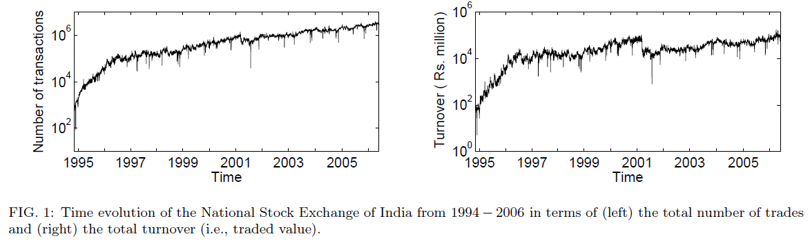
6. Market Index Return Distribution⁵
Growth of the Indian stock market
⁵ Pan RK and Sinha S (2008) Inverse cubic law of index fluctuation distribution in Indian markets, Physica A 387, 2055-2065.

Slide 29
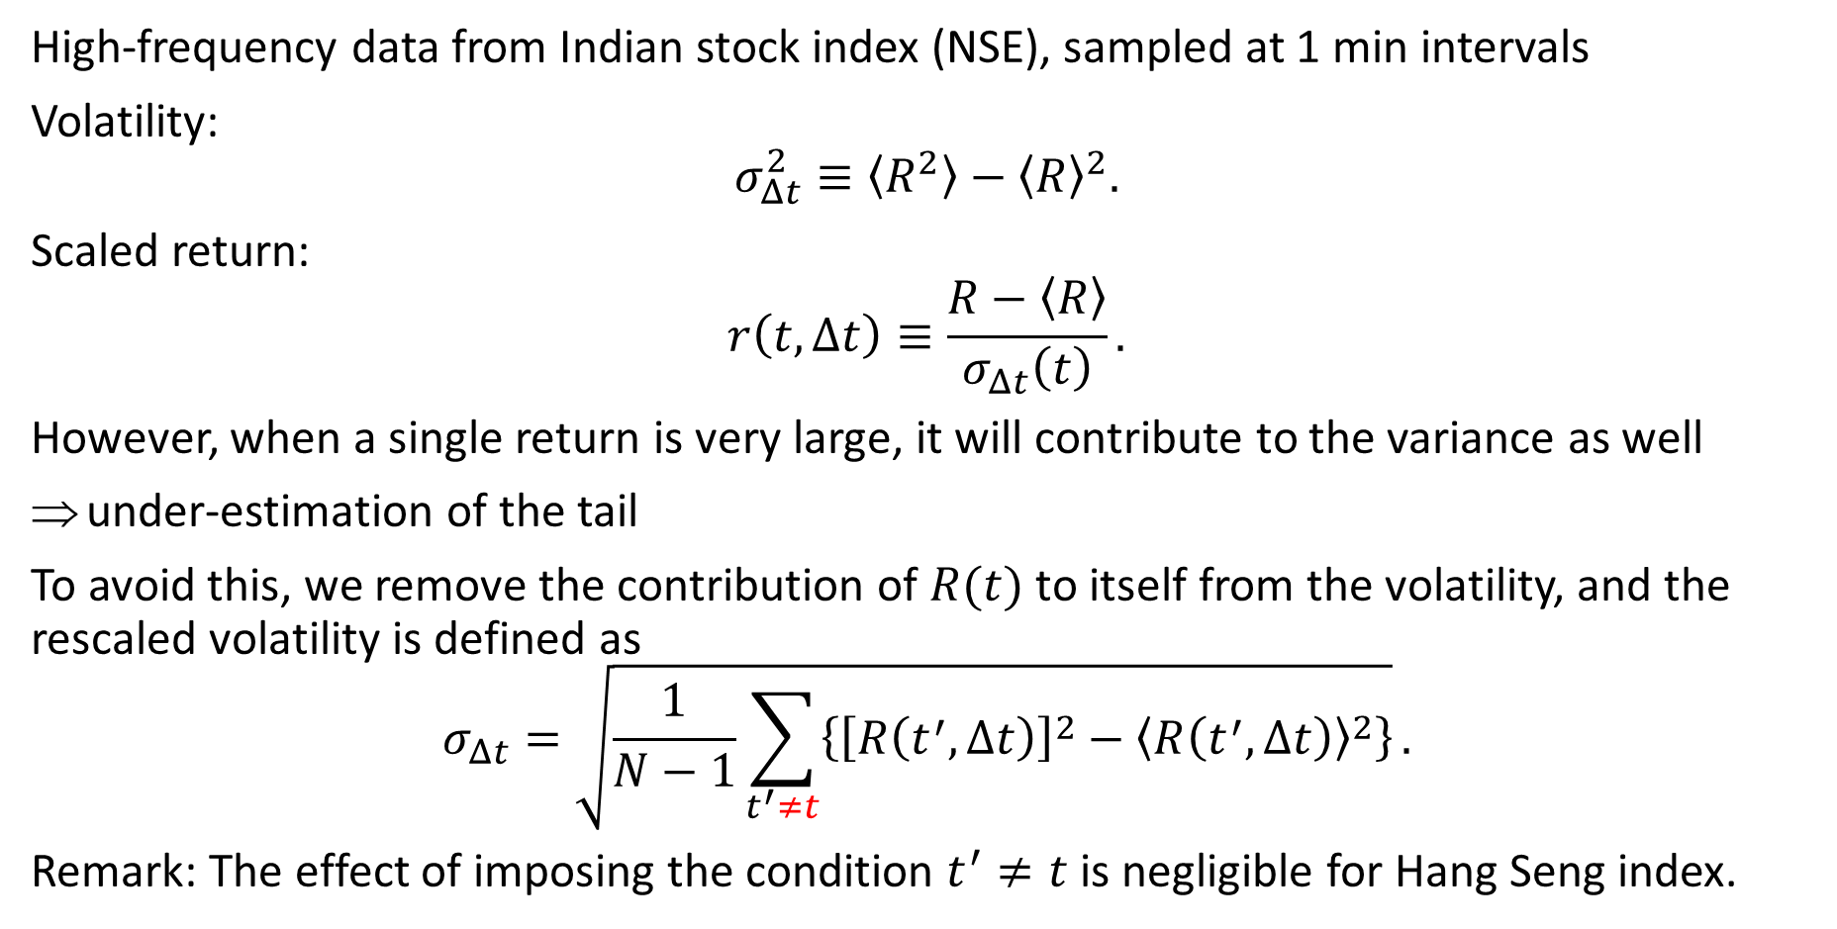
Market Index Return
High-frequency data from Indian stock index (NSE), sampled at 1 min intervals
Volatility:
$$σ_{Δt}^{2}≡〈R^{2}〉−{〈R〉}^{2}.$$
Scaled return:
$$r\left(t,Δt\right)≡\frac{R−〈R〉}{σ_{Δt}\left(t\right)}.$$
However, when a single return is very large, it will contribute to the variance as well
under-estimation of the tail
To avoid this, we remove the contribution of $R(t)$ to itself from the volatility, and the rescaled volatility is defined as
$$σ_{Δt}=\sqrt{\frac{1}{N−1}\sum_{t^{′}≠t}{\left\{{\left[R\left(t^{′},Δt\right)\right]}^{2}−{〈R\left(t^{′},Δt\right)〉}^{2}\right\}}}.$$
Remark: The effect of imposing the condition $t^{′}≠t$ is negligible for Hang Seng index.

Slide 30
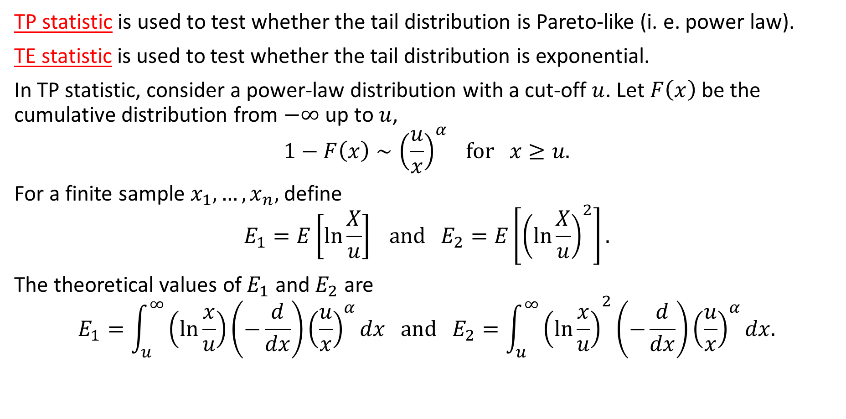
Test for the Tail Distribution⁶
TP statistic is used to test whether the tail distribution is Pareto-like (i. e. power law).
TE statistic is used to test whether the tail distribution is exponential.
In TP statistic, consider a power-law distribution with a cut-off $u$. Let $F\left(x\right)$ be the cumulative distribution from $−∞$ up to $u$,
$$1−F\left(x\right)∼{\left(\frac{u}{x}\right)}^{α} for x≥u.$$
For a finite sample $x_{1},…,x_{n},$ define
$$E_{1}=E\left[\ln{\frac{X}{u}}\right] and E_{2}=E\left[{\left(\ln{\frac{X}{u}}\right)}^{2}\right].$$
The theoretical values of $E_{1}$ and $E_{2}$ are
$$E_{1}=\int_{u}^{∞}{\left(\ln{\frac{x}{u}}\right)}\left(−\frac{d}{dx}\right){\left(\frac{u}{x}\right)}^{α}dx and E_{2}={\int_{u}^{∞}{\left(\ln{\frac{x}{u}}\right)}}^{2}\left(−\frac{d}{dx}\right){\left(\frac{u}{x}\right)}^{α}dx.$$
⁶ Pisarenko V and Sornette D (2006) New statistic for financial return distribution: power law or exponential? Physica A 366, 387-400.

Slide 31
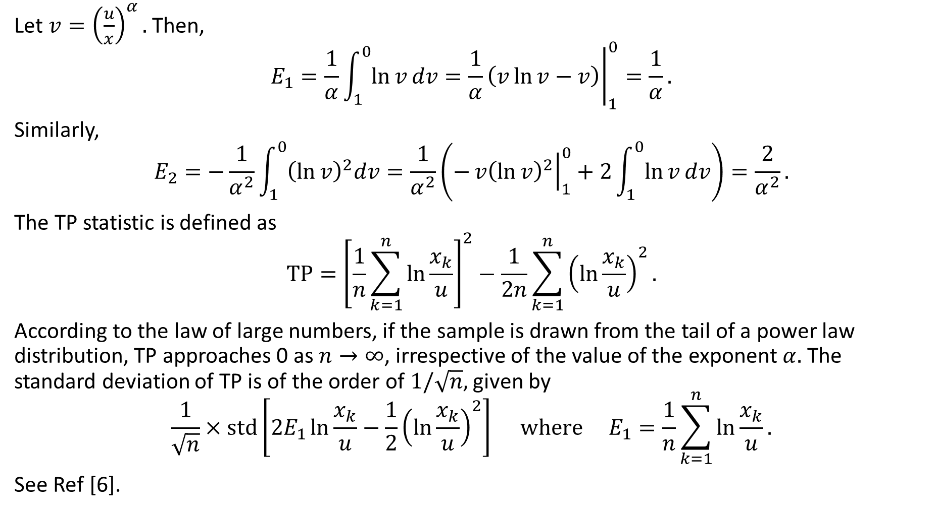
TP Statistic (2)
Let ${v=\left(\frac{u}{x}\right)}^{α}.$ Then,
$$E_{1}=\frac{1}{α}\int_{1}^{0}{\ln{v}dv}={\left.\frac{1}{α}\left(v\ln{v}−v\right)\right|}_{1}^{0}=\frac{1}{α}.$$
Similarly,
$$E_{2}=−\frac{1}{α^{2}}\int_{1}^{0}{{\left(\ln{v}\right)}^{2}dv}=\frac{1}{α^{2}}\left(−{\left.v{\left(\ln{v}\right)}^{2}\right|}_{1}^{0}+2\int_{1}^{0}{\ln{v}dv}\right)=\frac{2}{α^{2}}.$$
The TP statistic is defined as
$$TP={\left[\frac{1}{n}\sum_{k=1}^{n}{\ln{\frac{x_{k}}{u}}}\right]}^{2}−\frac{1}{2n}\sum_{k=1}^{n}{{\left(\ln{\frac{x_{k}}{u}}\right)}^{2}}.$$
According to the law of large numbers, if the sample is drawn from the tail of a power law distribution, TP approaches 0 as $n→∞$, irrespective of the value of the exponent $α.$ The standard deviation of TP is of the order of $1/\sqrt{n},$ given by
$$\frac{1}{\sqrt{n}}×std\left[2E_{1}\ln{\frac{x_{k}}{u}}−\frac{1}{2}{\left(\ln{\frac{x_{k}}{u}}\right)}^{2}\right] where E_{1}=\frac{1}{n}\sum_{k=1}^{n}{\ln{\frac{x_{k}}{u}}}.$$
See Ref [6].

Slide 32
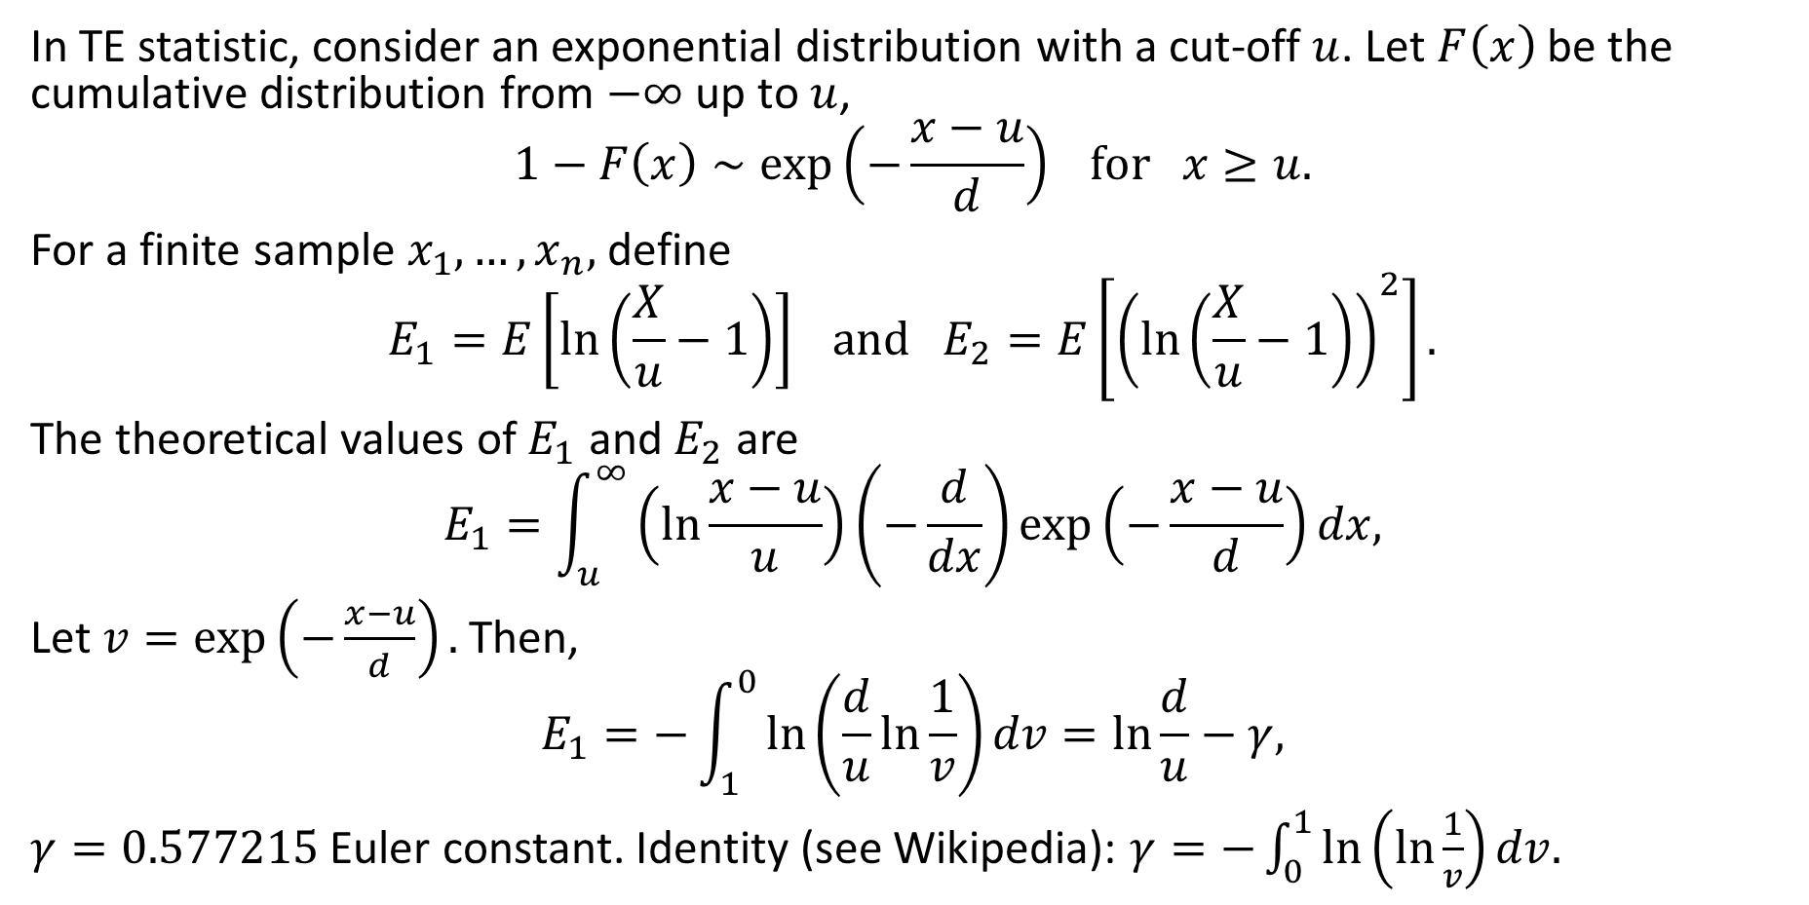
TE Statistic (1)
In TE statistic, consider an exponential distribution with a cut-off $u$. Let $F\left(x\right)$ be the cumulative distribution from $−∞$ up to $u$,
$$1−F\left(x\right)∼\exp\left(−\frac{x−u}{d}\right) for x≥u.$$
For a finite sample $x_{1},…,x_{n},$ define
$$E_{1}=E\left[\ln\left(\frac{X}{u}−1\right)\right] and E_{2}=E\left[{\left(\ln\left(\frac{X}{u}−1\right)\right)}^{2}\right].$$
The theoretical values of $E_{1}$ and $E_{2}$ are
$$E_{1}=\int_{u}^{∞}{\left(\ln{\frac{x−u}{u}}\right)}\left(−\frac{d}{dx}\right)\exp\left(−\frac{x−u}{d}\right)dx,$$
Let $v=\exp\left(−\frac{x−u}{d}\right).$ Then,
$$E_{1}=−\int_{1}^{0}{\ln\left(\frac{d}{u}\ln{\frac{1}{v}}\right)}dv=\ln{\frac{d}{u}}−γ,$$
$γ=0.577215$ Euler constant. Identity (see Wikipedia): $γ=−\int_{0}^{1}{\ln\left(\ln{\frac{1}{v}}\right)}dv.$

Slide 33
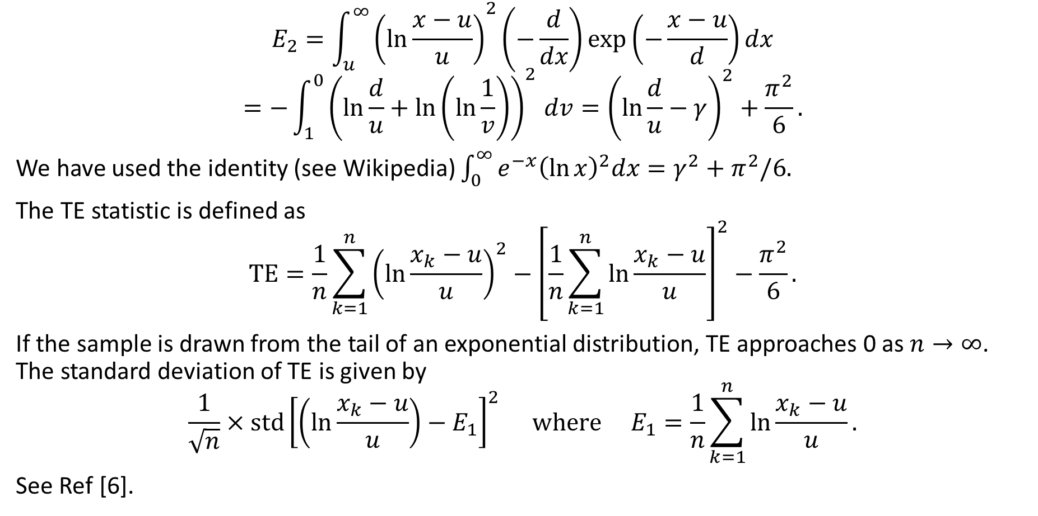
TE Statistic (2)
$$E_{2}={\int_{u}^{∞}{\left(\ln{\frac{x−u}{u}}\right)}}^{2}\left(−\frac{d}{dx}\right)\exp\left(−\frac{x−u}{d}\right)dx$$
$${=−\int_{1}^{0}{\left(\ln{\frac{d}{u}}+\ln\left(\ln{\frac{1}{v}}\right)\right)}}^{2}dv={\left(\ln{\frac{d}{u}}−γ\right)}^{2}+\frac{π^{2}}{6}.$$
We have used the identity (see Wikipedia) $\int_{0}^{∞}{e^{−x}{\left(\ln{x}\right)}^{2}dx}=γ^{2}+π^{2}/6.$
The TE statistic is defined as
$$TE=\frac{1}{n}\sum_{k=1}^{n}{{\left(\ln{\frac{x_{k}−u}{u}}\right)}^{2}}−{\left[\frac{1}{n}\sum_{k=1}^{n}{\ln{\frac{x_{k}−u}{u}}}\right]}^{2}−\frac{π^{2}}{6}.$$
If the sample is drawn from the tail of an exponential distribution, TE approaches 0 as $n→∞$. The standard deviation of TE is given by
$$\frac{1}{\sqrt{n}}×std{\left[\left(\ln{\frac{x_{k}−u}{u}}\right)−E_{1}\right]}^{2} where E_{1}=\frac{1}{n}\sum_{k=1}^{n}{\ln{\frac{x_{k}−u}{u}}}.$$
See Ref [6].

Slide 34
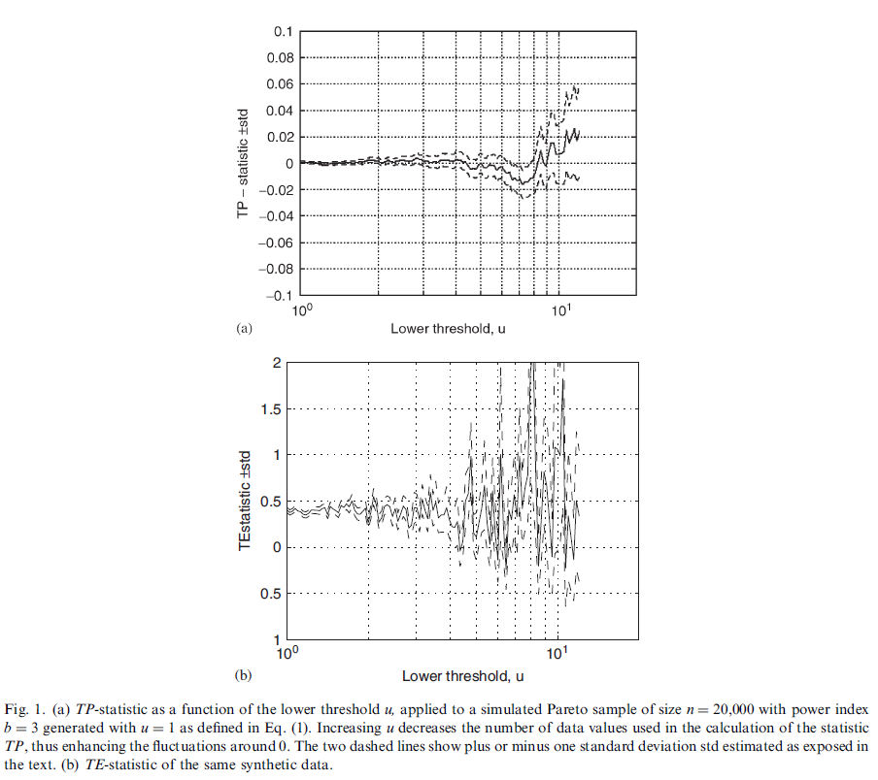
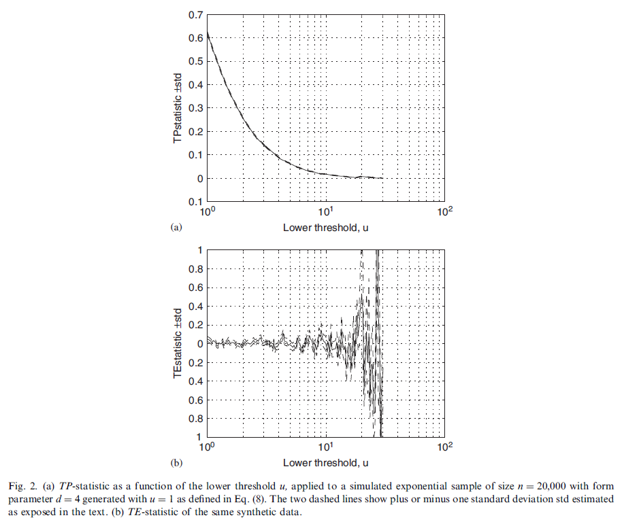
Tests on Simulated Data
Simulated Pareto sample
Simulated exponential sample
Power-law like
Sample size effect
Exponential unlikely
Exponential-like

Slide 35
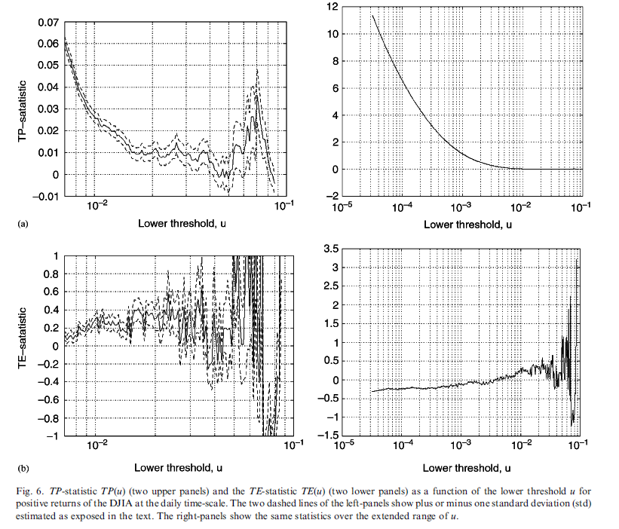
Application to Dow Jones Industrial Average (DJIA)
Sample size effect
Deviations from power law
Convergence to power law
Exponential law unlikely

Slide 36
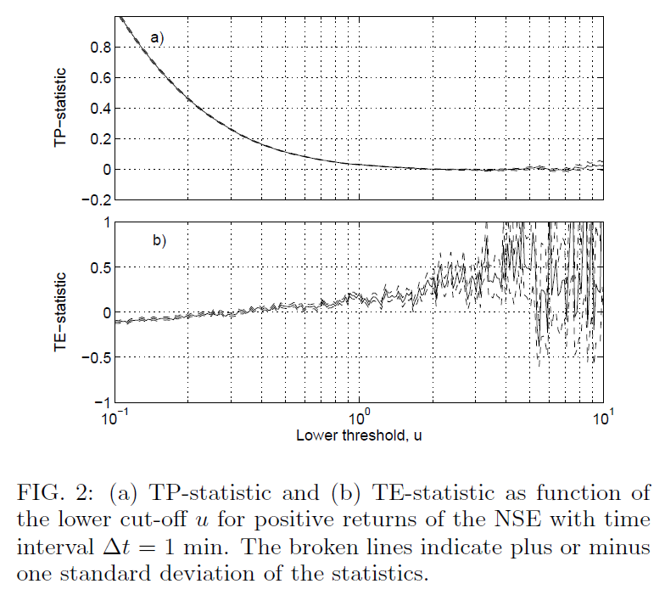
Application to Indian Stock Index NSE
Deviations from power law
Convergence to power law
Exponential law unlikely

Slide 37
Remarks
Graphical fitting of power laws are often subjective, particularly in the choice of the lower cut-off. This is illustrated by the different regimes of TP and TE statistics.
TP and TE statistics confirm the tendency for the tails to resemble more and more a power-law for the highest quantiles.
However, clear deviations suggest that the structure of the tails of the distributions of returns is more complex than usually assumed.
Power laws are observed in emerging markets just like developed markets. Universal mechanisms?
See Ref [6] for other simulated distributions (Student-t, stretched exponential, Gaussian). Their behaviors are different.
See Ref [6] for the application to NASDAQ return distributions.

Slide 38
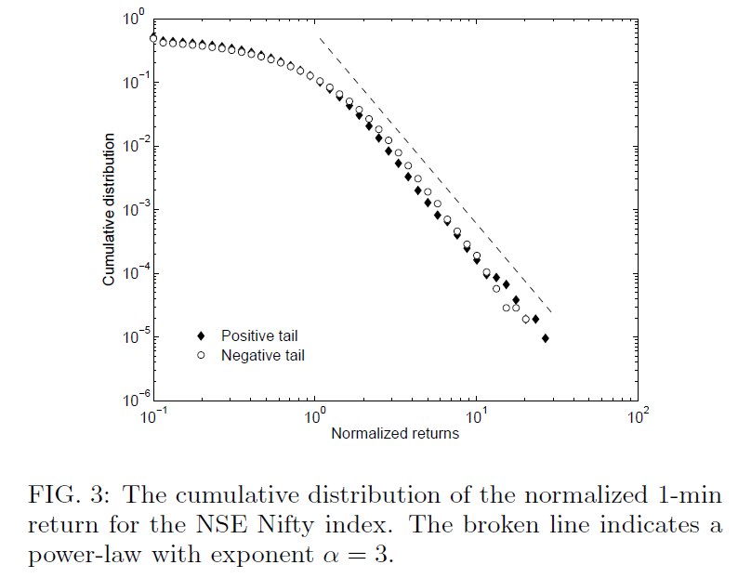
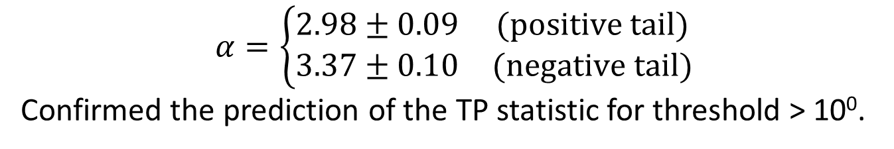
NSE Nifty Index (1 min return)
$$α=\left\{\begin{matrix}2.98±0.09 & (positive tail) \\ 3.37±0.10 & (negative tail)\end{matrix}\right.$$
Confirmed the prediction of the TP statistic for threshold > 10⁰.

Slide 39
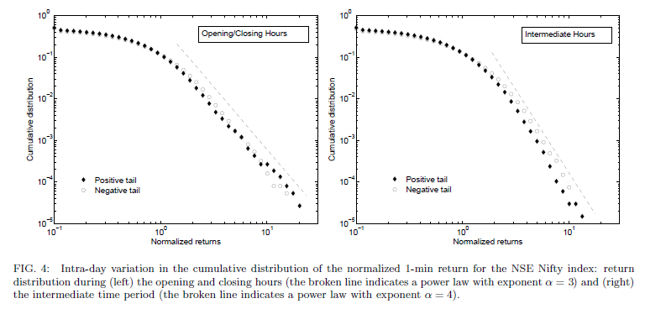
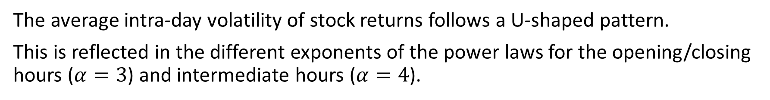
Temporal Variations in the Return Distribution
The average intra-day volatility of stock returns follows a U-shaped pattern.
This is reflected in the different exponents of the power laws for the opening/closing hours ($α=3$) and intermediate hours ($α=4$).

Slide 40
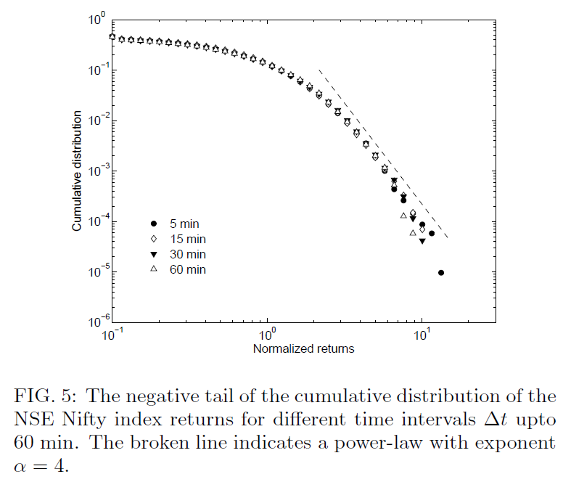
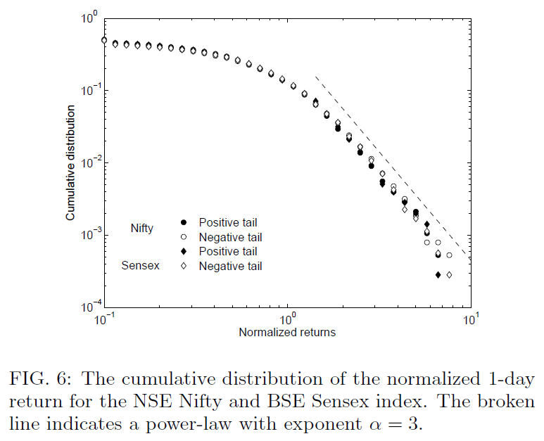
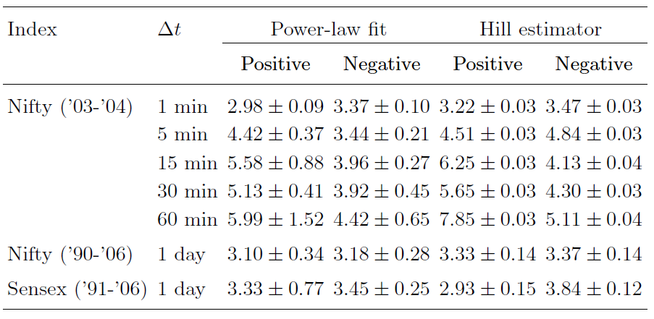


Dependence on $Δt$?
Index values are sampled at the end of intervals of duration $Δt$, or averaged over the interval.
The distribution is a power law for $Δt$ up to 60 minutes.
At longer time scales $α$ increases and the distribution slowly converges to Gaussian behavior (not enough data!).
With enough data, $Δt$ = 1 day still yields a power law with $α$ close to 3.

